Slide 1
History Heroes Term 1, Week 3
https://www.youtube.com/watch?v=lXgkuM2NhYI 0.50-1.00

Slide 2
Question 1 (1 mark full name)
Which President abolished slavery in 1865?

Slide 3
Question 2 (9 marks, 1 for each state)
Which US states make up the West region of USA?

Slide 4
Question 3 (2 marks)
From the 1850s which were the two main political parties?

Slide 5
Question 4 (1 mark)
How many immigrants entered USA between 1850 and 1914?

Slide 6
Question 5 (1 mark)
Define ‘mass consumption’.

Slide 7
ANSWERS

Slide 8
Question 1 (1 mark full name)
Which President abolished slavery in 1865?
Abraham Lincoln

Slide 9
Question 2 (9 marks, 1 for each state)
Which US states make up the West region of USA?
Colorado, California, Idaho, Montana, Nevada, Oregon, Utah, Washington, Wyoming

Slide 10
Question 3 (2 marks)
From the 1850s which were the two main political parties in the US?
Democrats and Republicans

Slide 11
Question 4 (1 mark)
How many immigrants entered USA between 1850 and 1914?
40 million

Slide 12
Question 5 (1 mark)
Define ‘mass consumption’.
The purchase of goods beyond the minimal need of food and shelter, by the majority of the population.

Slide 13
Total
/14

Slide 14
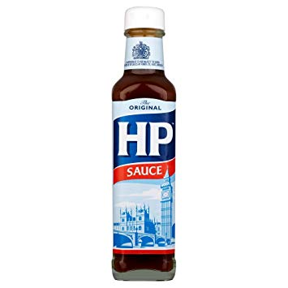

Source
of
the
week!

Slide 15
“ Immigration had made the USA a very mixed society. By 1920 there were 103 different nationalities living there. The motto on the Great Seal of the USA is E pluribus unum which means: ‘From the many: one.’ The idea was that America was like a melting pot, where immigrants lost their old identity and became Americans.
In practice, however, each new group of immigrants was treated with great suspicion by many of those who had already settled in America.”
-T. Fiehn et al. (2002). The USA Between the Wars 1919-1941. London, England: John Murray Publishers

